Slide 1


K.L.N.College of Engineering
An Autonomous Institution | Accredited by NAAC
(Approved by AICTE, New Delhi & Affiliated to Anna University, Chennai)
Department of Electronics and Communication Engineering
An ESP 32 based Healthcare monitoring using integrating multiple sensors using Integromat and Random Forest algorithm
Guided By
Mr.S.R.Naresh (ASP/ECE)
Presented By
Bernis Mariya X (910620103012)
Ilamathi S (910620103026)
Latikaa Tejus J (910620103037)

Slide 2
Introduction to the project
In today's fast-paced world, monitoring vital signs efficiently and accurately is crucial for maintaining optimal health.
Our project addresses this need by combining the power of ESP32 microcontroller with advanced sensor technology and machine learning algorithms.
Vital signs like SPO2, Heart rate and temperature are monitored, Random forest algorithm and automation software are used.

Slide 3
Objectives
Creating an unified ecosystem that can seamlessly collect, analyze and deliver critical medical informations through integrated sensors like MAX30102,NTC and Pulse rate sensors
This involves integration of Integromat, an automation tool with a webhook to facilitate seamless transfer of data between the Arduino IDE and external platforms.
The random forest algorithm implemented in Python, enhances our framework with predictive analytical capabilities by generating a collection of physiological simulations which provide a personalized healthcare plan

Slide 4
Literature Survey
Base Paper Title : | Design of a portable low-power wearable heart rate and blood oxygen monitoring system
Year of Publication : | 2021
Authors : | Quanyu Wu , Enxiang Jiang, Feijie Dai, Wenxi Zhang, Ye Wang, Xiaojie Liu
Journal Name : | Research gate publication
Inference : | Developing a portable system for heart rate, blood oxygen, and body temperature monitoring offers societal and clinical economic benefits.

Slide 5
Existing System
The existing system covers innovative applications in healthcare monitoring, and home automation using IoT devices. This likely involves integrating sensors, microcontrollers, and wireless communication modules to create a Smart Health Monitoring Device for real-time tracking of vital signs.
It enables users to interact with devices using natural language commands through NLP and machine learning algorithms.
These approaches represent technological advancements aimed at improving healthcare, enhancing user-device interaction, and enabling smarter automation solutions.

Slide 6
Requirements
Hardware requirements
MAX 30102
NTC
PULSE RATE SENSOR
ESP 32 WROOM
PC
Breadboard
Connecting wires
Software requirements
Arduino IDE 2.3.2
Google Sheets
Webhooks
Blynk
Windows 10 OS

Slide 7
Proposed System
The inclusion of the ESP32 WROOM module, MAX30102, NTC thermistor, and pulse sensor in the Arduino IDE
The system efficiently organizes and stores the data collected from these sensors in designated folders and Excel sheets
Blynk is an empowering tool users to control the Health care kit in real time.
Seamless data transfer and integration with external platforms Integromat automation tool and webhooks enable instant action and transmission of critical health information.

Slide 8
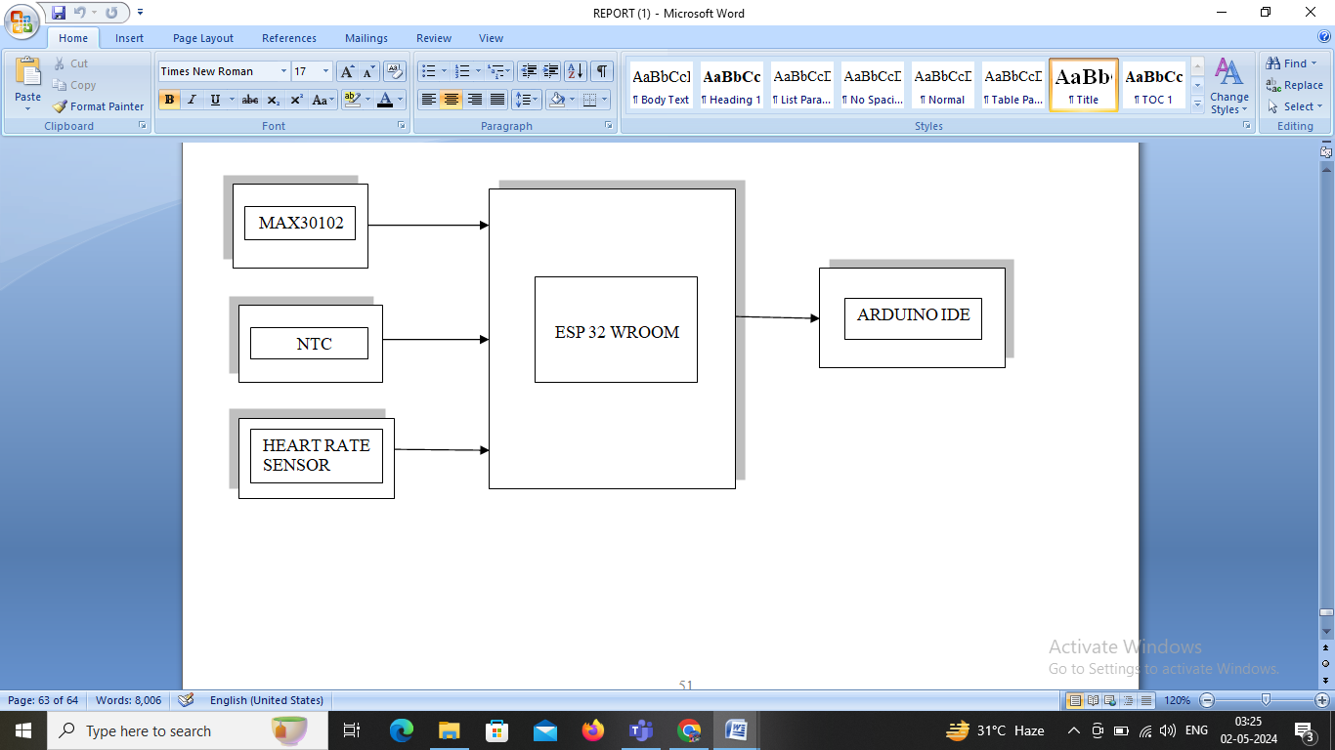
BLOCK DIAGRAM
HARDWARE PROCESS

Slide 9
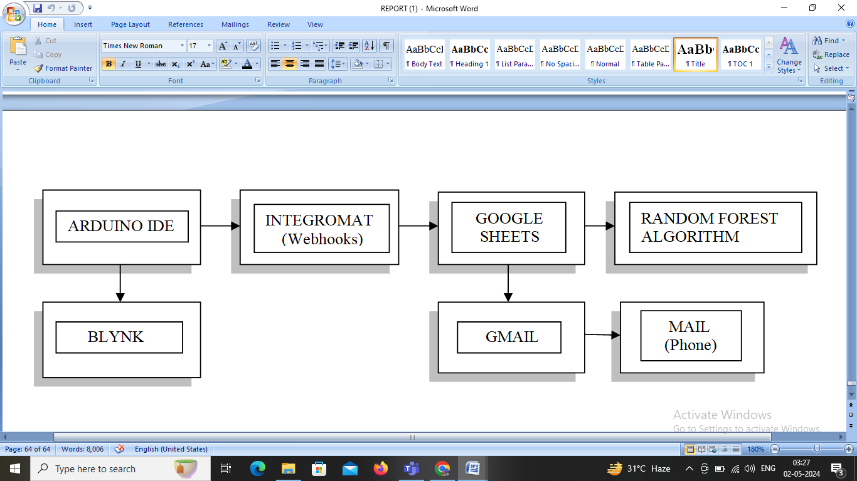
BLOCK DIAGRAM
SOFTWARE PROCESS

Slide 10
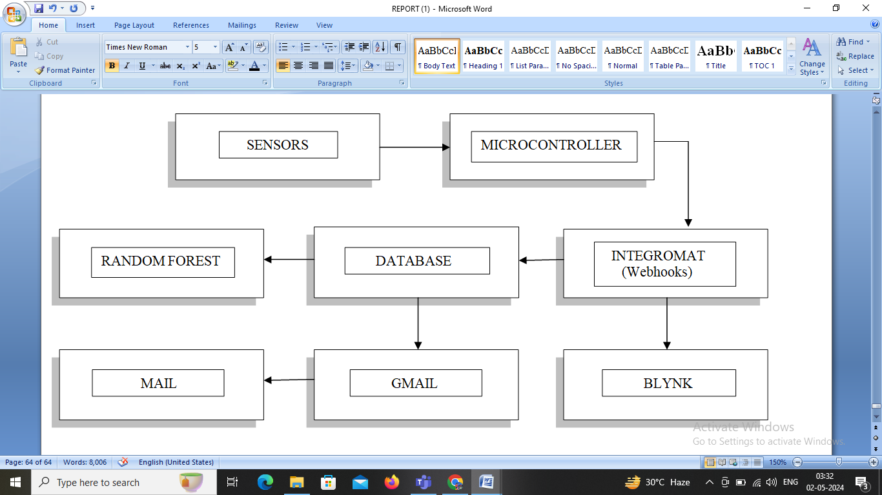
BLOCK DIAGRAM
OVERALL BLOCK DIAGRAM

Slide 11
ALGORITHM
RANDOM FOREST
Random Forest is a type of ensemble learning method. It operates by constructing a multitude of decision trees during training and outputting the class that is the mode of the classes (classification) or mean prediction (regression) of the individual trees.
Each decision tree in the random forest is trained on a random subset of the training data and a random subset of features. Random Forest also introduces randomness in feature selection.
In classification tasks, each tree in the Random Forest independently predicts the class label of a data point, and the class with the most votes across all trees is assigned as the final prediction. In regression tasks, the output of each tree is averaged to produce the final prediction

Slide 12
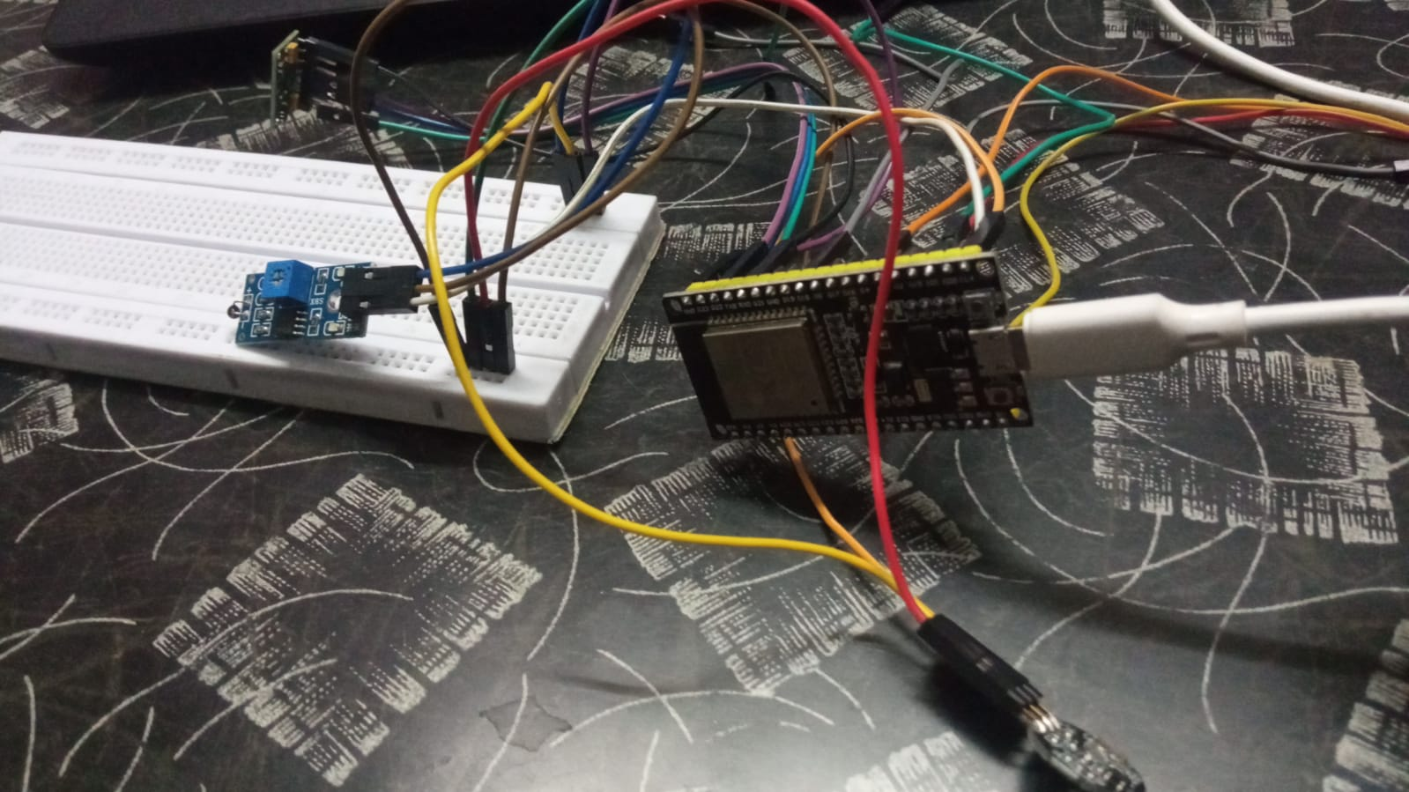

OUTPUT SCREENSHOTS

Slide 13
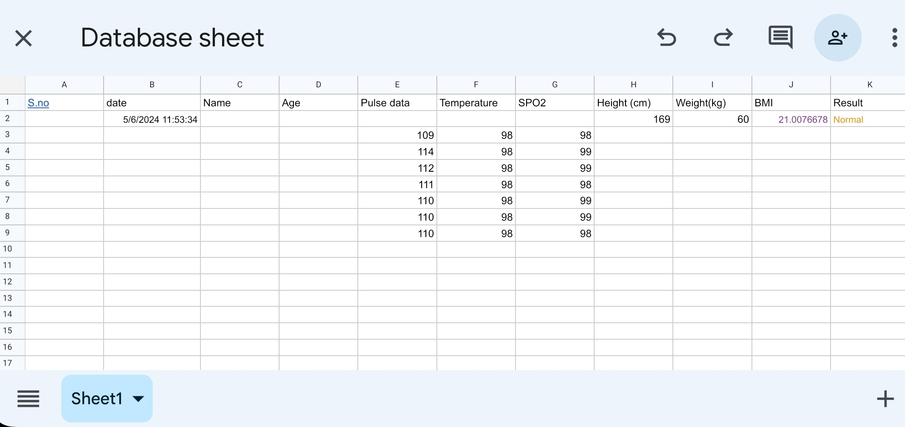
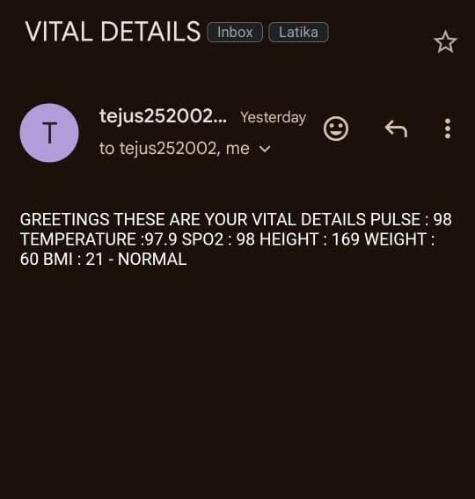
OUTPUT SCREENSHOTS

Slide 14
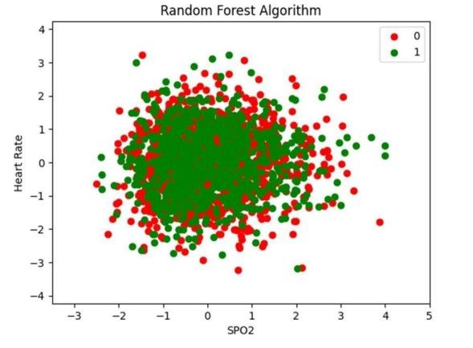
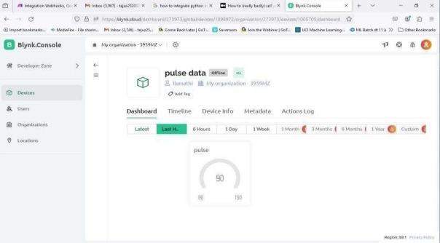
OUTPUT SCREENSHOTS

Slide 15
Conclusion
Robust monitoring system for real-time data collection and transmission.
Delivery of timely and informed insights for improved health outcomes.
Integration with Integeromat for seamless data transfer.
Utilization of web hooks for accessibility.
Implementation of predictive analytics using the Random Forest algorithm.
Automated email notifications for patients to engage with their health data proactively.

Slide 16
References
Charanya K Rao1, Nithyashree R NagashreeR Nadig3, Sushma T4 ”.Smart Health Monitoring Device International Research Journal of Engineering andTechnology (IRJET) e-ISSN: 2395-0056 Volume: 09 Issue:06 | Jun 2022
Dhruv Piyush Parik1, Bhavuk Mittal2, Amogh Pal3 “Virtual Voice Assistant Based on Voice Flow”International Journal for Research in Applied Science & Engineering Technology (IJRA)ISSN: 2321-9653; IC Value: 45.98; SJ Impact Factor: 7.429Volume 9 Issue XI Nov 2021
V. Pravalika, Ch.”Internet of Things Based Home Monitoring and Device Control Using Esp32” Rajendra Prasad International Journal of Recent Technology and Engineering (IJRTE) ISSN: 2277-3878, Volume-8, Issue-1S4, June 2019
Bhagwati Kamble1, Rupali Khune2, Sunita Shinde3, Priyanka Raut4, Neeta Kulkarni5,”Heart Rate Monitoring By Using pulse sensor”International Research Journal of Engineering and Technology (IRJET) e-ISSN: 2395-0056 Volume: 06 Issue: 04 | Apr 2019

Slide 17
References
Vaishnavi Khadasane, Mrunalini Desai, Devashree Khatavkar, Shruti Lad “ADVANCED FINGERPRINT AUTHENTICATION SYSTEM IN TWO WHEELERS” International Journal of Technical Research and Applications e-ISSN: 2320-8163,www.ijtra.com Special Issue 40 (KCCI MSR) (March 2016), PP. 42-45
Vrushali Y Kulkarni, 2Pradeep K Sinha “Effective Learning and Classification using Random Forest Algorithm”ISSN: 2277-3754 ISO 9001:2008 Certified International Journal of Engineering and Innovative Technology (IJEIT)Volume 3, Issue 11, May 2014
NTC Thermistor Performance and Linearization of its Temperature-Resistance Characteristics Using Electronic Circuit International Journal of Advances in Scientific Research and Engineering (IJASRE), ISSN:2454-8006, DOI: 10.31695/IJASRE
M.Jaya lakshmi1 , C.Sadia Sameen2 , D.Maneesha3 , G.Dharani 4 , K.Farhat Mubeena5”Smart Home using Blynk App Based On IOT “ International Journal of creative Research Thoughts (IJCRT)

Slide 18
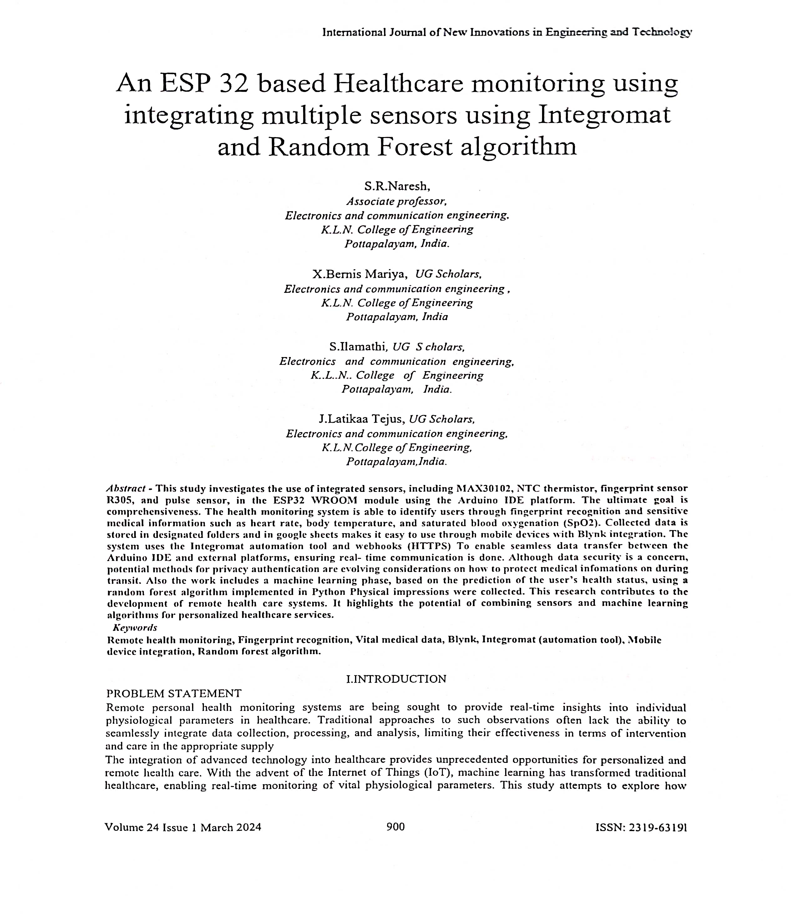
JOURNAL PUBLICATIONS

Slide 19
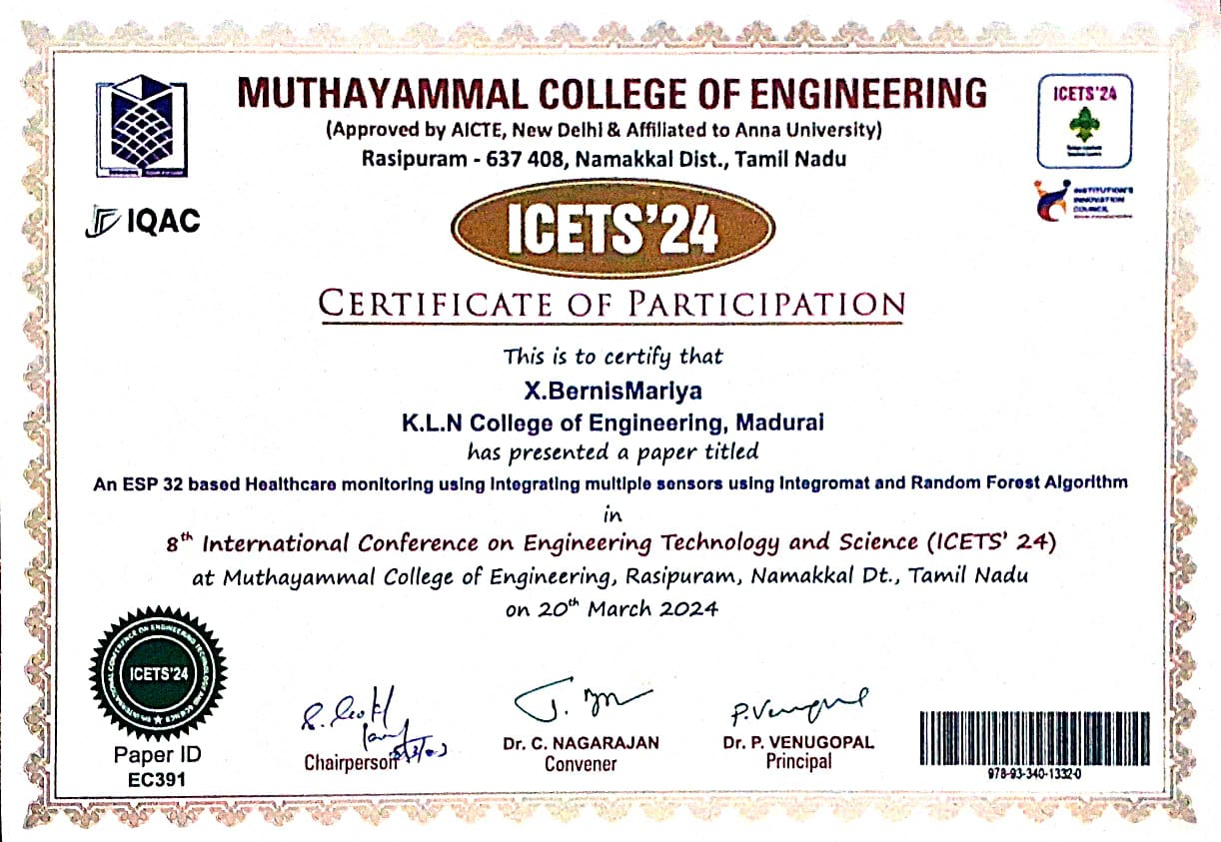
Conference Certificate

Slide 20
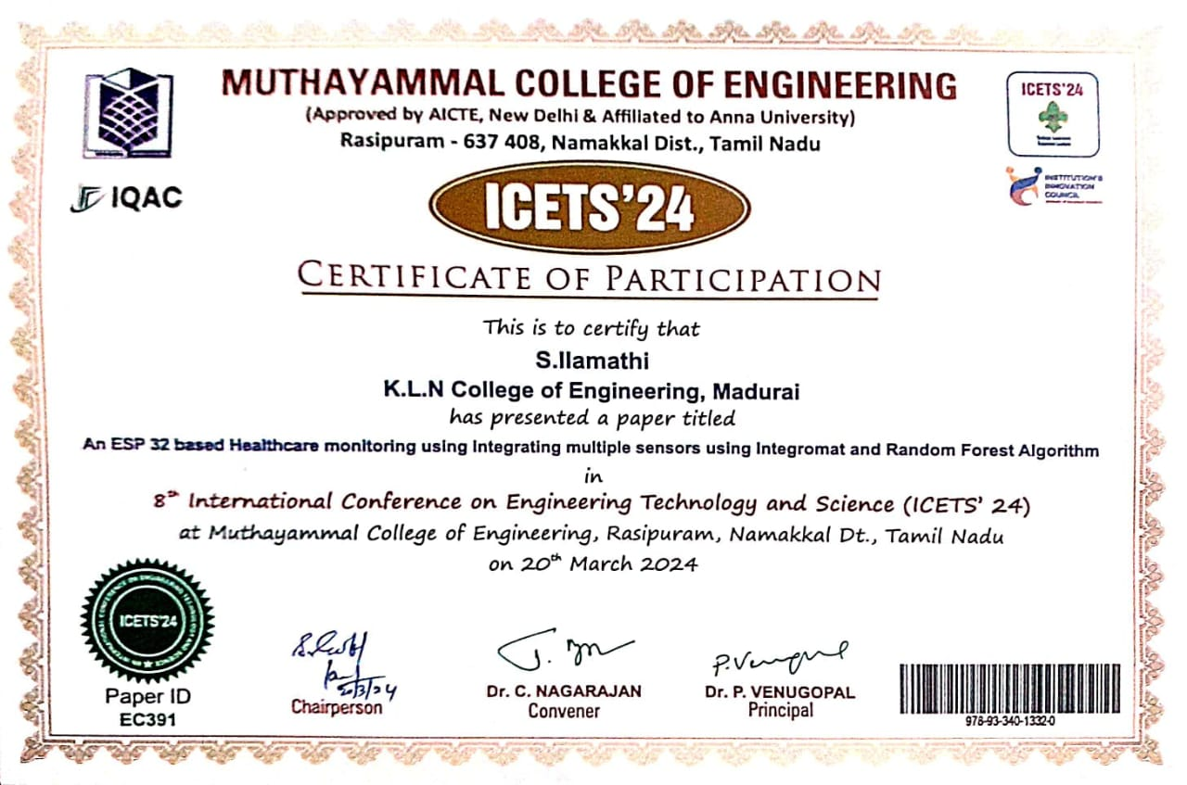
Conference Certificate

Slide 21
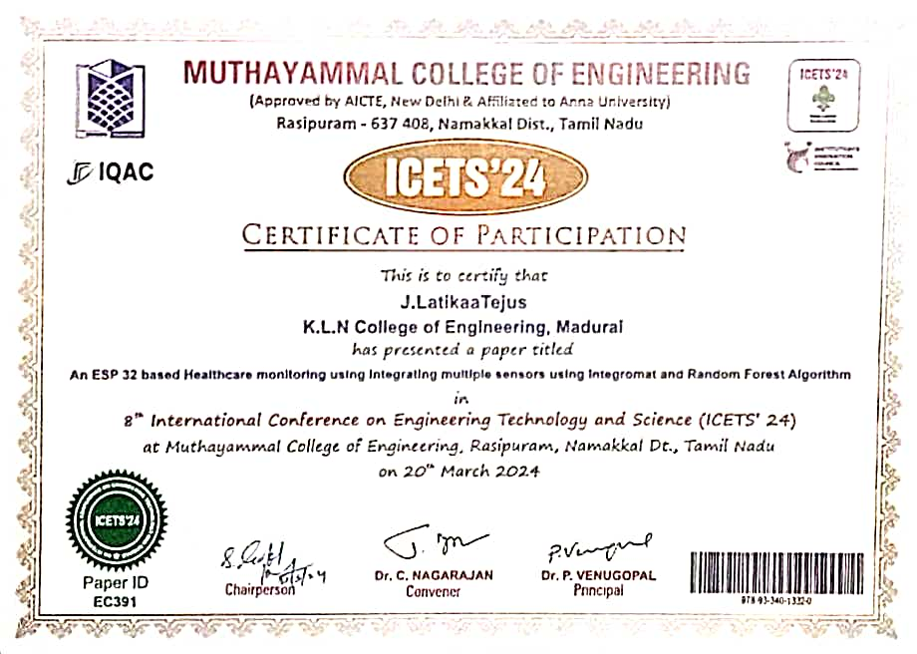
Conference Certificate

Slide 22
Thank You

